Slide 1

ESP Tentative Negotiated Agreement -
May 2018
Notes:
No one wanted less than you deserve. In fact, that was the phrase Colleen used many times, ESP are not less than. Given the deficit and the significant health care crisis we got the best possible deal we could after about 15 meetings with the HCPSS and countless additional meetings with ourselves to strategize how we can get the best offer possible for our members. The language we won throughout the rest of the tentative agreement is significant in that much of it is parity to other contracts and puts ESP on equal footing with other employees. Out of all the articles opened back in October, from both the Board and from us, we believe that, other than salary, each one of them was resolved in our favor. We fought back successfully against language that would weaken the contract and we preserved existing language. We won some language that will “literally” protect food and nutrition staff. We are disappointed that a partial step is what we are offering you, but given that we protected health care and won over 50 language items our team believes this is the best agreement that we can get at this time.

Slide 2

Article 3 - Association Rights
Current Language -Employee lists-No later than October 1 and February 1 of each year, the Board shall provide the Association with the name and work location of each employee eligible for representation by the Association.
New Agreement - The Board shall provide the Association with the name, position classification, work location, home address, home and work telephone numbers, personal cell phone numbers, and work email address of each employee eligible for representation by the Association. Said bargaining unit lists shall be provided on a quarterly basis, however, the information of new hires shall be provided within 30 days of hire.
Current Language - Orientation - The Association shall be allowed to distribute materials to new employees through the Office of Human Resources. The Association shall also be provided a place on the agenda during ESP orientations sponsored by the Office of Professional and Organizational Development. When feasible, the Association shall be permitted to present information to the Nurses at their annual orientation.
New Agreement- The Association shall be allowed to distribute materials to new employees through the Office of Human Resources. The Association shall be notified at least 10 days in advance of all employee processing session dates and times and also be provided a place on the agenda during ESP processing. The Association shall be permitted to present information to Nurses at their annual orientation.
Notes:
Given that we won so many language items we can’t possibly go through everyone tonight. Here are the highlights. Access to ESP employees has always been less than ideal given the hiring dates and the work locations of some of the staff. This new language in Articles 3.10 and 3.13 will enable us to more effectively communicate with new employees and engage them in the union. HB811

Slide 3

Article 3 - Association Rights
Current Language - Association Communications- The Association shall be permitted to utilize the school delivery system (PONY) for the distribution of Association materials, provided that such distribution does not interfere with the distribution of the materials of the school system. However, the Association agrees not to use the school delivery system for the following:
Political materials.
Advertising materials for business establishments or brand
name materials not contained in official Association publications.
New Agreement - Maintains current language.
Notes:
The Board wanted to significantly alter the ways in which the Association can communicate with its members and limit the topics discussed using the Pony and/or school system e-mail. We were able to demonstrate that there is no history of abuse and that we already govern our communications effectively and professionally.

Slide 4

Article 4 - Employee Rights
Current Language - No language
New Agreement - School-based employees will be provided up to five (5) designated hours during pre-service week to complete online compliance training.
A joint committee was formed to survey, review and update employee job descriptions.
Notes:
Fair Labor Standards requires HCPSS give school based employees time during their duty day to complete all work, we’ve secured language so that all members know it’s their right. Adequate time must be provided in the schedule to complete all the modules. While there is no contract language, a joint committee was formed and work has already begun. A joint HCEA/BOE Job Description was sent to all school based para’s and secretaries so that the updating work can begin.

Slide 5

Article 5 - Voluntary Transfers
Current Language - 5.C - Recommendations for voluntary transfers for paraeducators, health assistant, security assistants, and student assistants for the ensuing year will not be accepted and/or processed after August 1. With approval of the releasing principal, this date can be waived until August 15 if the request does not cause hardship on the educational program. An employee must accept the voluntary transfer unless the request is withdrawn, in writing, prior to August 1. Assistants who accept voluntary transfers on or between August 1 and August 15 will not be released until a placement is found for the transferring assistant.
New Agreement - Recommendations for voluntary transfers for paraeducators, health assistant, security assistants, and student assistants for the ensuing year will not be accepted and/or processed after August 1. With approval of the releasing principal, this date can be waived until August 15 if the request does not cause hardship on the educational program. An employee will have until August 1 to withdraw his/her transfer request or accept/deny in writing via email, any transfer offered by the principal. The acceptance/denial must be made within 24 hours of the written email transfer offer from the principal. If the employee declines the transfer offer, or fails to respond within 24 hours after the offer, his/her name will be removed from that school’s transfer list for that school year.
Notes:
Language added that allows an employee to accept/decline a voluntary transfer. HCPSS viewed the current language as they had the right to transfer the employee without formally offering the position.

Slide 6

Article 6 - Evaluations
MOU agreed to for a joint committee on evaluations.
Notes:
ESP evaluations have been a constant problem. This joint committee will give us an opportunity to share what works and doesn’t work and time to develop and implement evaluations that work for each job type.

Slide 7

Article 7 - Bereavement Leave
Current Language - An employee shall be allowed five (5) consecutive weekdays of absence without loss of salary upon the death of the employee’s relative: a child, parent, brother, sister, husband, wife, same-sex domestic partner, daughter-in-law, son-in-law, sister-in-law, brother-in-law, grandparent, grandparent of spouse, grandchild, stepchild, mother-in-law, father-in-law, or anyone who has lived regularly in his/her household for at least two (2) years within the last five (5) years. Two (2) consecutive work days of bereavement leave will be allowed for the death of an aunt, uncle, niece, or nephew of the employee.
One day of the allowable bereavement leave may be used within 90 work days of the relative’s death to attend a memorial service.

Slide 8

Article 7-Bereavement Leave
New Agreement - An employee shall be granted five (5) consecutive duty days of absence without loss of salary for death in the immediate family. Immediate family shall include child, parent, brother, sister, husband, wife, domestic partner, mother-in-law, father-in-law, son-in-law, daughter-in-law, brother-in-law, sister-in-law, grandparent, grandchild, stepchild, step-parent, step-brother, step-sister, grandparent of spouse/domestic partner, biological parent of the employee’s child, or of anyone who has lived regularly in the household of the employee for at least two (2) years within the last five (5) years.
Upon the death of an uncle, aunt, niece, or nephew, the employee will be granted two (2) duty days of absence at any one time without the loss of salary.
One day of the allowable bereavement leave may be used within 90 work days of the relative’s death to attend a memorial service. The 90 day time limit may be waived by the Office of Human Resources on a case-by-case basis.
Notes:
We worked hard to maintain and improve bereavement leave language. HCPSS wanted to reduce the number of days you could take for certain family members. We removed the words “same sex” so that it includes all domestic partners. We also added anything that you see in bold, italics, and underlined. The team feels this language was a big win.

Slide 9

Article 7 - Military Leave
Current Language -All employees who are members of the military or naval establishments of the United States or of the State of Maryland shall be granted leave on those days during which they shall be engaged in any military or naval duty to which they shall be ordered y proper authority, not to exceed fifteen (15) working days in any calendar year without loss of pay for the days included in such leave.
New Agreement - Request for leave for military service should be submitted to the Office of Human Resources and will be approved in compliance with current federal law/regulation.
Eligible employees will also receive up to fifteen (15) days of paid leave per year for military training.
Notes:
The language was updated to be in accordance with federal regulation.

Slide 10
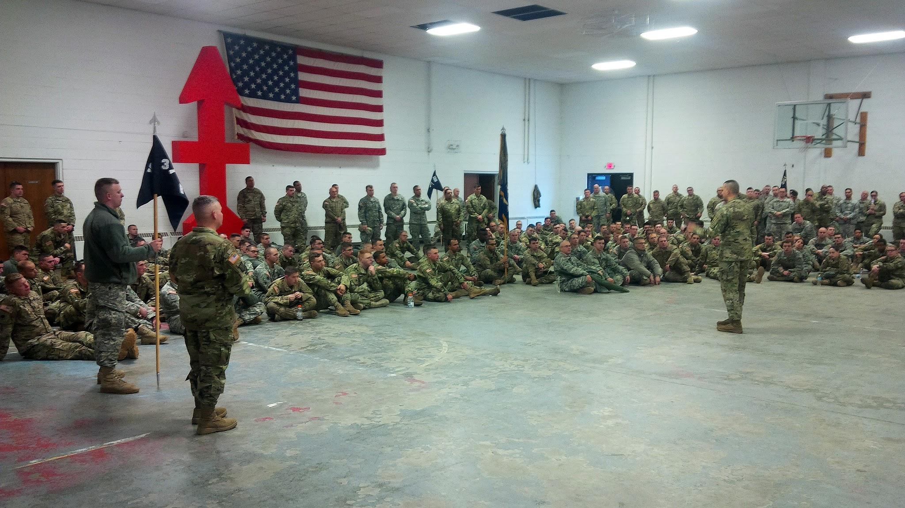
Article 7 -Leaves
Current Language - A leave of absence without pay of up to two (2) years may be granted to any employee who serves in the Peace Corps or Americorps.
New Agreement - A leave of absence without pay of up to two (2) years may be granted to any employee who serves in the Peace Corps or Americorps. Upon return from leave granted pursuant to 7.8 and 7.16 of this Article, an employee shall be restored to his/her former position or to a position of like nature and status and will be considered as if he/she were actively employed by the Board during the leave and will be placed on the salary schedule at the level he/she would have achieved if he/she had not been absent.
Notes:
The additional language was added to help protect members serving in the Peace Corps or Americorps.

Slide 11

Article 9-Protection of Members
Current Language - No current language
New Agreement - All schools must have a two-way communication system in which an employee can initiate calls to the school office. Schools presently without such a system shall have them included in their Safety/Security Plans.
Notes:
After many years of working on this protection we were able to finally secure language supporting the role of school based ESP and the safety of our students and schools. We discussed the need for walkie-talkies and/or devices that will allow ESP to communicate with the office at all times, especially while on the playground during recess.

Slide 12

Article 9 - Protection of Members
Current Language -no language
New Agreement - The Board shall provide an Employee Assistance Program (EAP) for employees who voluntarily seek assistance.
Notes:
We have had the EAP for years but getting it in the contract ensures the benefit of free counseling for staff will continue. The EAP is an important benefit that a lot of members do not know about and everyone can benefit at one time or another in their career for the sometimes, life saving, advice from a professional counselor.

Slide 13
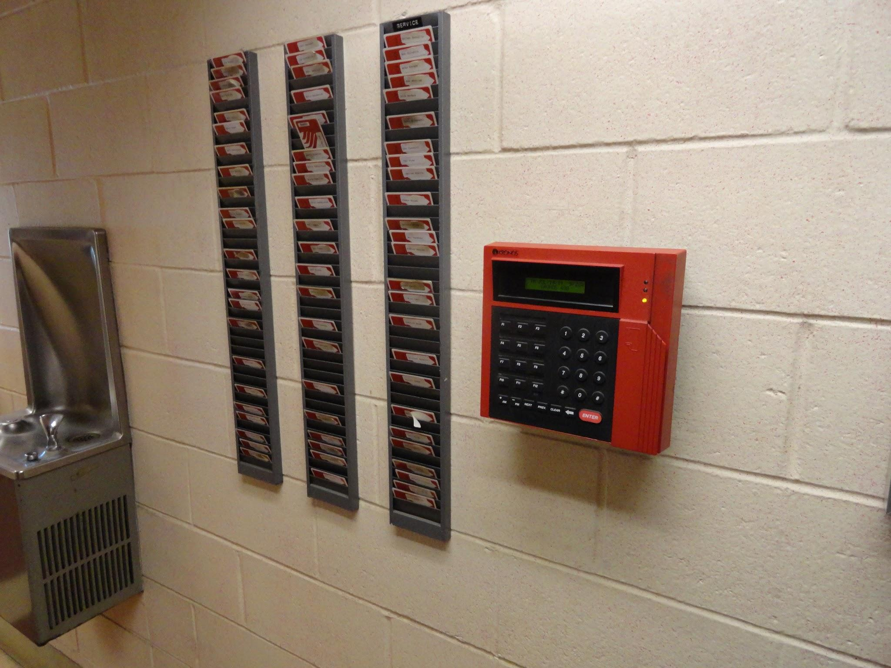
Article 11 - Working Hours & Working Conditions
Current Language -no language
New Agreement - Food and Nutritional Service Assistance will not be required to take their duty-free lunch break at the end of their shift.
New Agreement- In arranging schedules for employees who are assigned to more than one work location, every effort will be made to limit the amount of travel between work locations. Adequate travel time shall be allowed for employees who are required to report to another work location during the duty day. Travel time shall be exclusive of lunch.
Notes:
These proposals have come up over the last several negotiation cycles and were still of concern to ESP employees. The Membership Committee met with Food and Nutritional staff and this is still one of their issues. Food/Nutrition staff were required to take their 30 minute duty free lunch at the end of their duty day and wait to clock out until after that time, even though they may only work a 3 hour shift.

Slide 14






Article 11 - Working Hours & Working Conditions
Current Language - No language
New Agreement- The Board shall make available, at no cost to the employee, appropriate protective and safety equipment for use in the performance of the employee’s job. (At the table we discussed need for arm guards, eye protection, clothing protection, protective gloves that are ¾ length, heat-resistant, waterproof and waterproof aprons.)
New Agreement- Employees are not required to clean up bodily fluids.
Notes:
Again, these were requests came from Food and Nutrition staff and our ESP working in the classroom. Food/Nutrition staff do not have proper heat resistant gloves, or waterproof aprons. Additionally classroom staff are asked to clean bodily fluids while the required Safe Schools training module specifies how to clean bodily fluids. This language adds an extra layer of protection for members.

Slide 15

Article 14 - Insurance Protection
Current Language - The Board will establish a committee, to include representation from all bargaining units, to provide input on the HCPSS health benefits program.
New Agreement - The creation of a Benefits Advisory Committee that will provide recommendations into maintaining quality and affordable healthcare benefits.
Notes:
This language is very important and will finally give HCEA a real role in ensuring we are aware of and consulted in this important benefit and association “Experts” will not be denied access to these meetings.

Slide 16

Article 19 - Salary Scales
Current Language - see current scales
New Agreement - Maintains the integrity of our new scale with a partial step for next school year (FY19).
Notes:
The delayed step is the equivalent of a half step for employees; however to avoid the craziness that occurred a few years ago, HCPSS will spread the increase over the entire school year so that employees paychecks will be consistent throughout the year.

Slide 17

Article 14 - Insurance Protection
Current Language - (see current plan design)
New Agreement - Maintains current health; prescription, dental, and vision plan design and $420 Benefits Credit for two years.
Concession - cut the $750 Benefits Credit for members who opt out of coverage.
Notes:
No deductibles, no increase in co-pays, and keeping the $420 Benefits Credit for members that elect to get coverage. We did agree to give up the Benefit Credit for members who opt out of coverage. This was a difficult decision, but we felt inclined to agree because this is an extreme outlier compared to other school systems, and even businesses. It’s extremely uncommon to pay someone who opts to NOT take coverage.

Slide 18

Summary
Two-year contract with limited openings in the second year for salary and one language article (not Article 14-health benefits).
Health insurance plan design is protected for two years.
Solid language protections throughout that ensure ESP is not less than.

